Slide 1


Retirement/EAS PPM Guide
MCB Quantico
Distribution Management Office
Bldg. 2009 Zeilin Road
Phone: (703) 784-2831/32/33

Slide 2
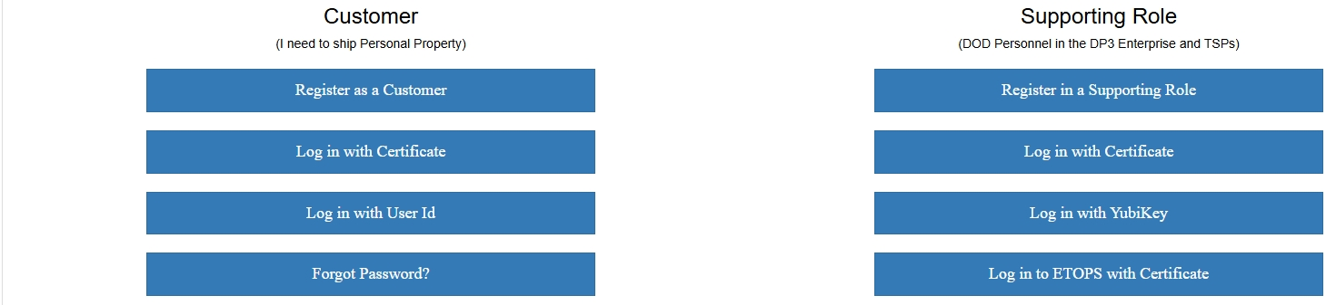
Setting up your account
Step 1: Navigate to DPS.MOVE.MIL.
Step 2: Click on the “Register as a Customer” tab.
Step 3: Fill in all the required information on screen Note: Use a personal email instead of a .Mil email address.
Step 4: Enter the captcha and click “Attach Certificate”
Step 5: Click Register.

Slide 3
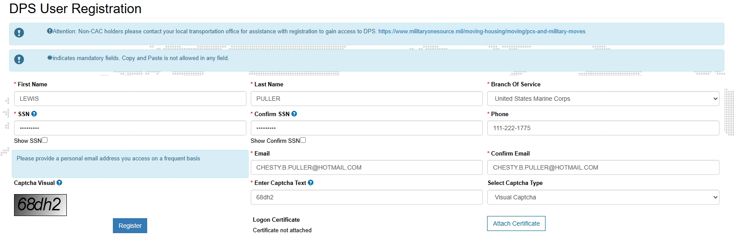
Setting up your account cont.
***Required Items are listed in RED***

Slide 4
Creating a move
Step 1: Navigate to DPS.MOVE.MIL.
Step 2: Click on the “Log in with Certificate” tab.
Step 3: Click on the “Create” or “Review” profile tab.
Step 4: Fill in all the required information on screen or edit any discrepancies.
Step 5: Click “Create Profile” or “Submit”
Step 6: You should have been redirected to the “home” page, if not then scroll to the top and click “home”
Step 7: Click on the “Start a New Move” tab.

Slide 5
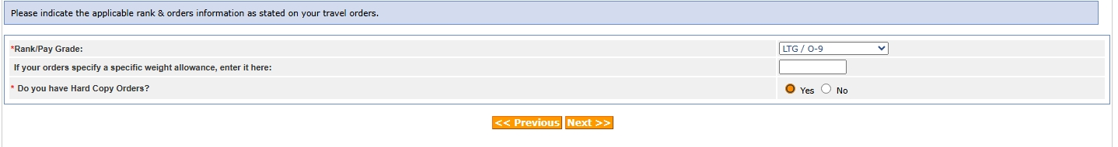
Rank & Hard Copy Orders
Select your rank.
Enter specific weight allowance IF orders specify.
Click “yes” for hard copy orders “DMO ALL PURPOSE LETTER”
Click Next.

Slide 6
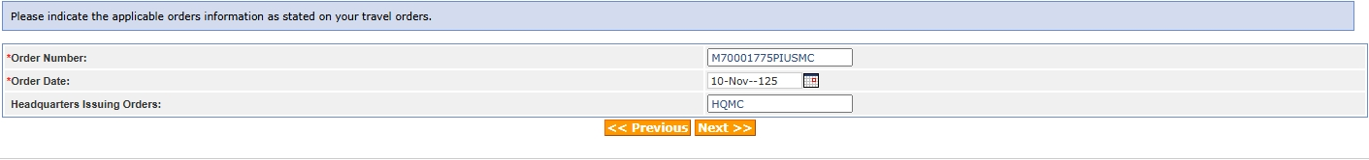

Orders Information
Type your order number (Travel - SDN).
Enter your order date
Type the Headquarters Issuing Orders: (HQMC for Marines)
Click Next.

Slide 7
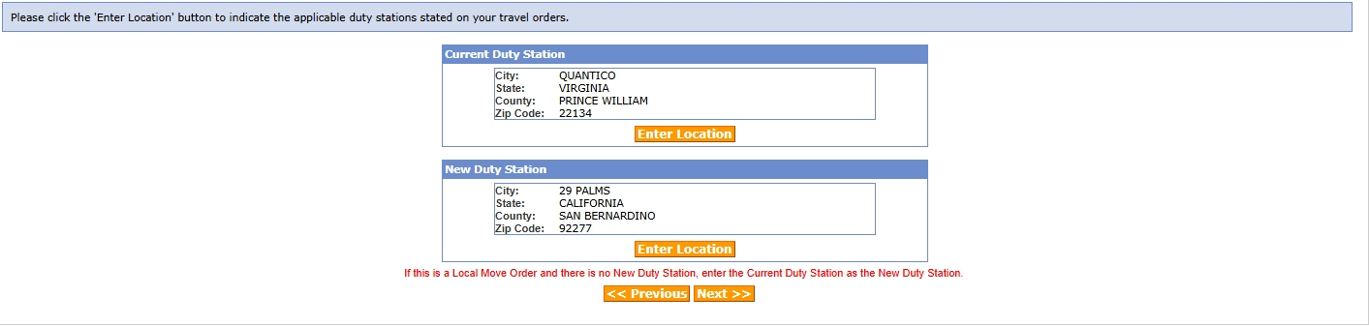
Duty Stations
Select your current duty station.
Select your Home or record/Home of Selection location.
Click Next.

Slide 8
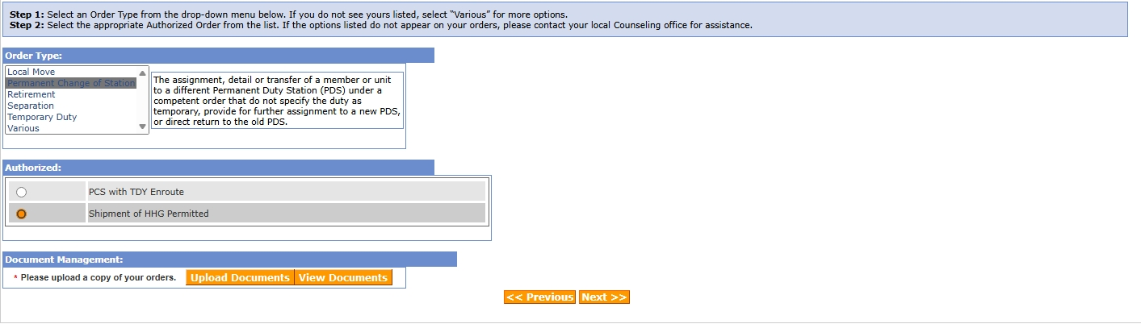
Order Selection
Select Order Type: EAS/Retirement
Click on Shipment of HHG Permitted.
Click upload documents.
Upload your DMO All Purpose Letter/Retirement/EAS Orders
Click Next.

Slide 9
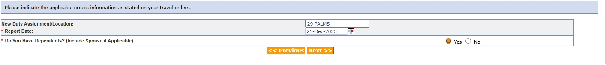
Tour Information
Type in Separating/Retiring as your new assignment
Enter your EAS/Retirement date.
Click Yes or No for dependents.
Click Next.

Slide 10
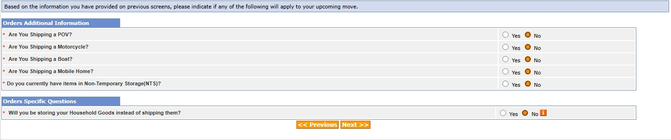
Additional Information
Click “yes” or “no” on all Additional Information.
Click Next.

Slide 11
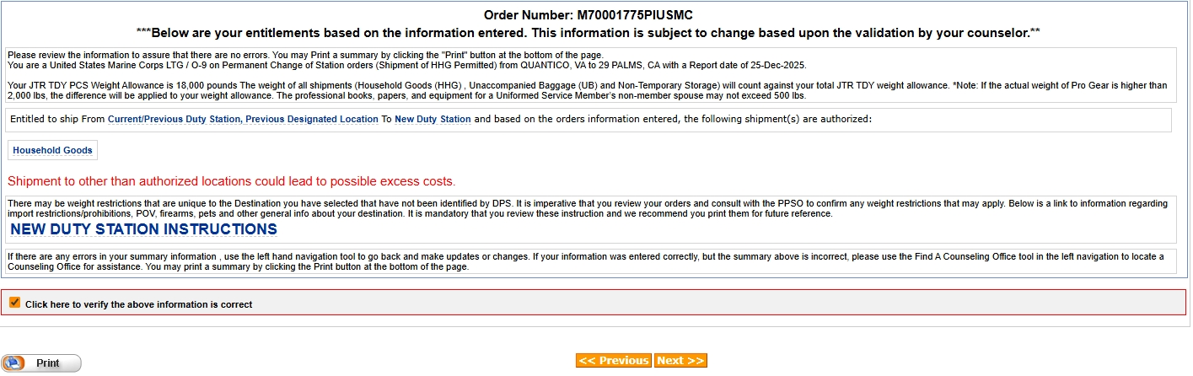
Entitlement Summary
Please read carefully the entitlement summary so that you may better understand your entitlements.
Click the acknowledgment box.
Click Next.

Slide 12



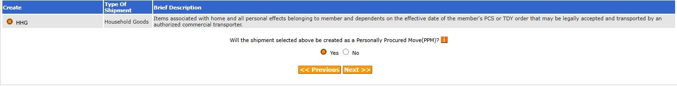


Create New Shipment
Click on HHG.
Click yes for PPM. (You are moving yourself)
Click next.

Slide 13
Shipment Information
Please read all shipment information carefully.
Click the acknowledgment box.
Click Next

Slide 14
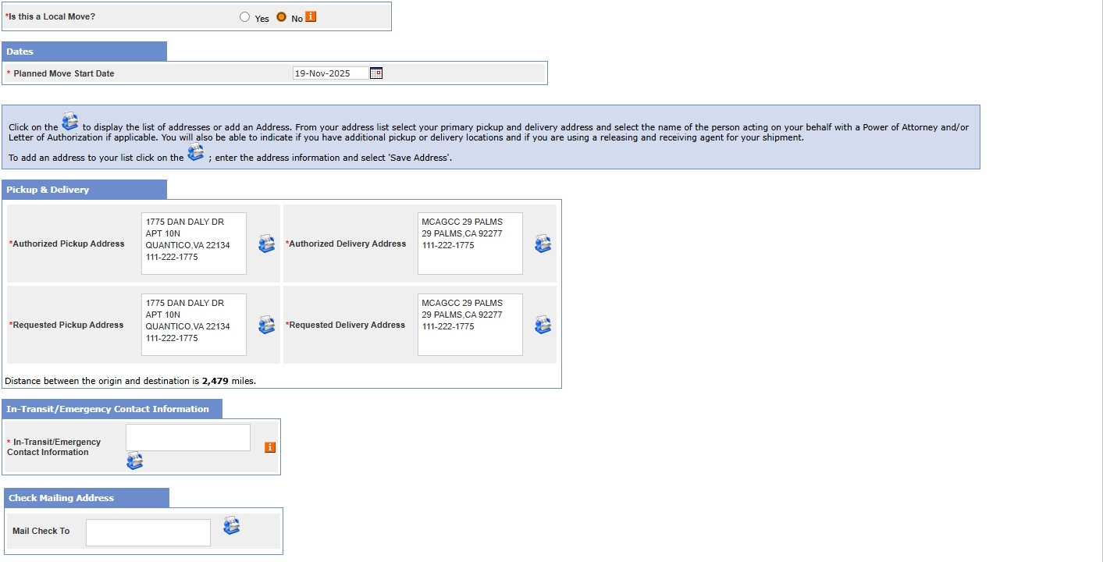
Pickup and Delivery
Click no on “Is this a Local Move”
Click no on “Is this shipment application for a release from Government provided non-temporary storage?”
Select your Planned Move Start Date.
Select your Pickup and Delivery Address. Note: Delivery address can be just the base/city you are EAS/Retiring to.
Select your In-Transit/Emergency Contact Information
Click Next.

Slide 15
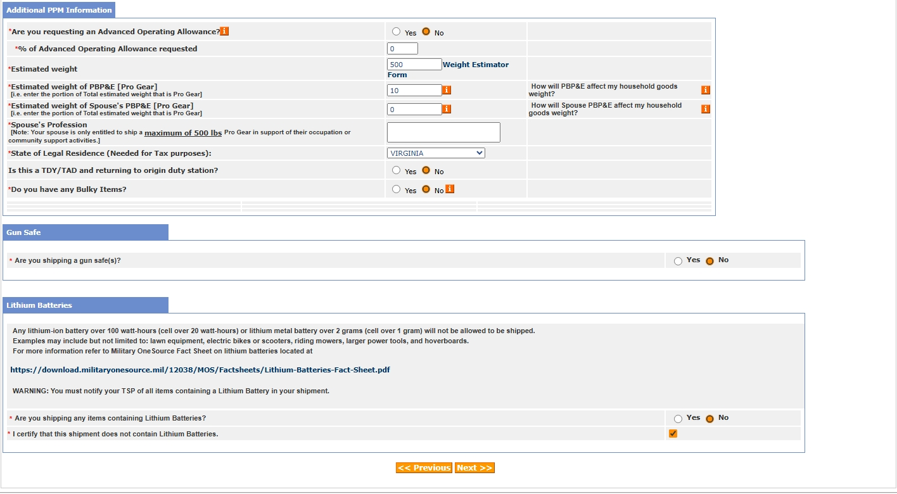
PPM Basic
If renting a UHAUL/Penske/BOX TRUCK, you may request an Advanced Operating Allowance. Must be approved by HQMC.
Enter your estimated weight. Note: A good rule of thumb is 1000lbs per room.
PRO GEAR should stay 10 and do not claim a gun safe as this will deduct from your weight, deducting from your reimbursement.
Select the state in which you pay taxes to.
Click yes or no on lithium-ion battery as applicable.
Click Next.

Slide 16
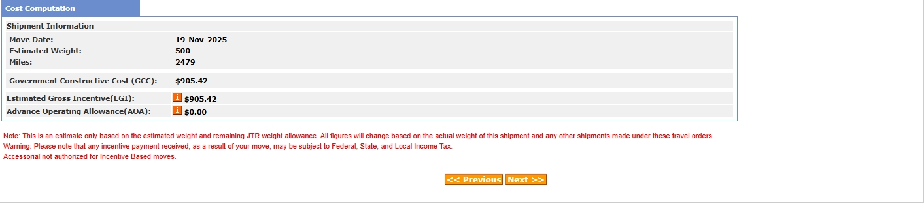
PPM Costing
Review the cost computation.
Click next.

Slide 17
Instructions and Shipment Summary
Carefully review and acknowledge the responsibilities and summary page(s).
Click Next.

Slide 18
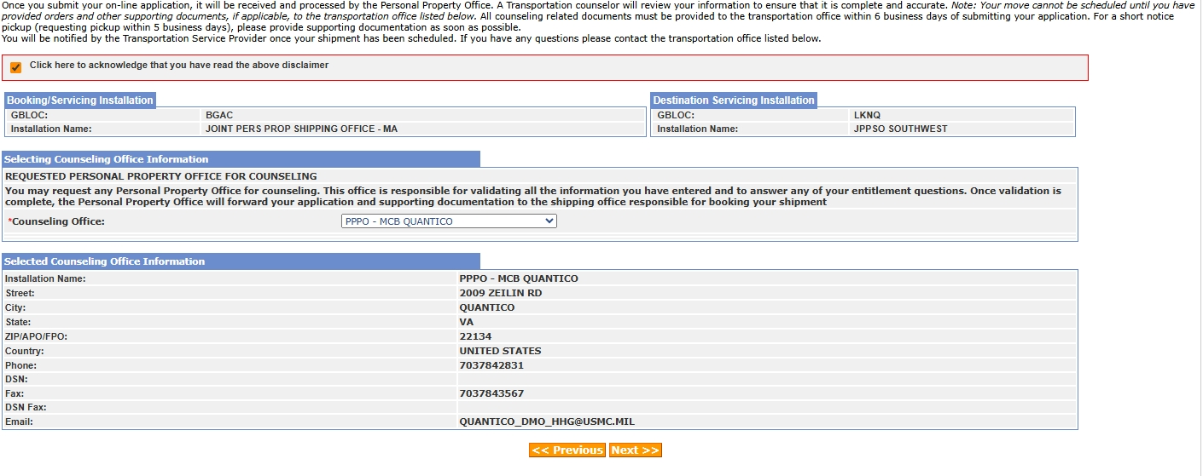
Counseling Office
Please read the disclaimer and click to acknowledge that you have read it.
Select “PPPO-MCB QUANTICO” as your counseling office. Note: If you do not see MCB Quantico as one of the options, please call our office for assistance.
Click Next.

Slide 19
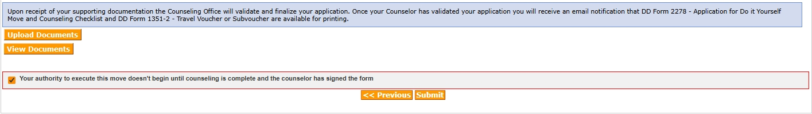
Shipment Submit
Click on the acknowledgment box.
Click submit.

Slide 20
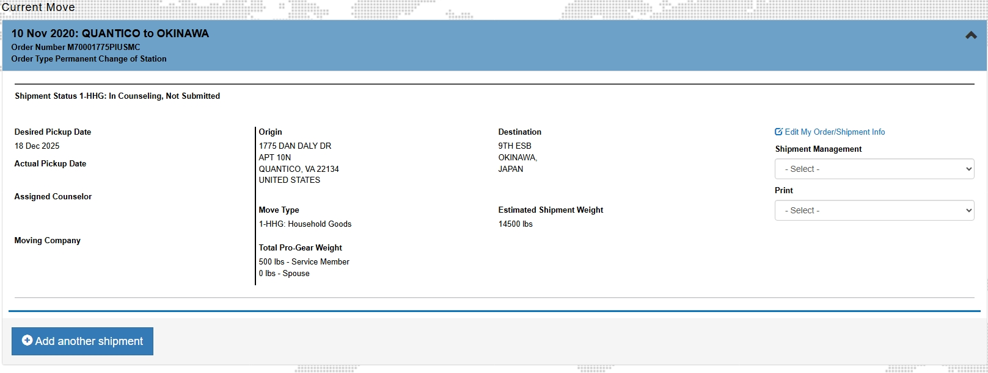
Add another shipment
To add another shipment to your existing shipment, e.g., adding a HHG shipment to the PPM you have created, click on “Home”.
Find the PPM shipment you created.
Scroll down until you see the “add another shipment” button.
Click it and follow the steps outlined in this guide.

